Slide 1









Whiteboardmaths.com
7
2
1
5
© 2004 All rights reserved

Slide 2




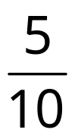

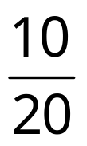
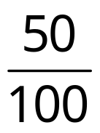
1/2
Equivalent Fractions
All these fractions are equivalent to ½ since they take up the same proportion of the shape. They are the result of multiplying ½ by 2/2, 3/3. 4/4, etc.
Notes:
You may only want to do one or two slides from the unit fractions at the start. All three have been done simply to give you more choice.

Slide 3
Equivalent Fractions
2
4
x ½
3
x ½
x ½
2
3
4
5
10
x ½
6
x ½
50
x ½
x ½
5
6
10
50
Notes:
Not strictly true that you multiply by 2, 3, 4, etc. You actually multiply by 2/2, 3/3, 4/4, etc. It may be advisable to explain here that you are actually multiplying by 1 which is why the fraction hasn’t changed in value.

Slide 4






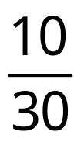
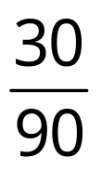
1/3
Equivalent Fractions
All these fractions are equivalent to 1/3 since they take up the same proportion of the shape. They are the result of multiplying 1/3 by 2/2, 3/3. 4/4, etc.

Slide 5
Equivalent Fractions
2
1
x
4
1
3
1
x
x
2
3
3
3
4
3
10
1
5
1
x
30
1
x
6
1
x
x
5
3
6
3
10
3
30
3

Slide 6


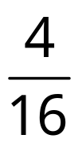
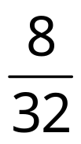
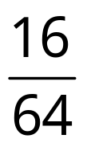
1/4
Equivalent Fractions
All these fractions are equivalent to ¼ since they take up the same proportion of the shape. They are the result of multiplying ¼ by 2/2, 3/3. 4/4, etc.

Slide 7
Equivalent Fractions
4
1
2
1
x
x
2
4
4
4
8
1
16
1
x
x
8
4
16
4

Slide 8

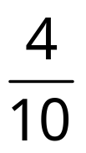

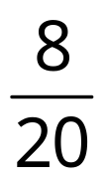
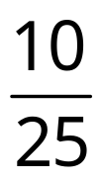
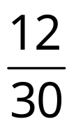
2/5
Equivalent Fractions
All these fractions are equivalent to 2/5 since they take up the same proportion of the shape. They are the result of multiplying 2/5 by 2/2, 3/3. 4/4, etc.

Slide 9
Equivalent Fractions
2
2
x
4
2
3
2
x
x
2
5
3
5
4
5
6
2
5
2
x
x
5
5
6
5

Slide 10

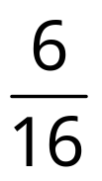
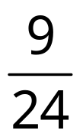
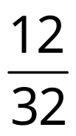
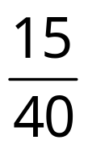
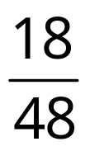
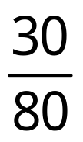
3/8
Equivalent Fractions
All these fractions are equivalent to 3/8 since they take up the same proportion of the shape. They are the result of multiplying 3/8 by 2/2, 3/3. 4/4, etc.

Slide 11
Equivalent Fractions
2
3
x
3
3
x
4
3
x
2
8
3
8
4
8
5
3
x
10
3
6
3
x
x
5
8
6
8
10
8
Notes:
9/24 requires grid filling in correctly. Same for 12/32

Slide 12
Simplest Form
Writing Fractions in Simplest Form
If a fraction can be simplified then we know that it’s numerator and denominator are both multiples of some number. To get the fraction in its simplest form we divide both the numerator and denominator by their highest common factor (HCF).

Slide 13

Writing Fractions in their Simplest Form

HCF of 6 and 18 = 6 so dividing top and bottom by 6 gives:
Example: Simplify

Slide 14

Writing Fractions in their Simplest Form

✗
Note that dividing by a factor (in this case 2) that is not the HCF will not give you the fraction in simplest form.
Example 1: Simplify

Slide 15

Writing Fractions in their Simplest Form

HCF of 10 and 25 = 5 so dividing top and bottom by 5 gives:
Example 2: Simplify

Slide 16

Writing Fractions in their Simplest Form

HCF of 18 and 48 = 6 so dividing top and bottom by 6 gives:
Example 3: Simplify

Slide 17
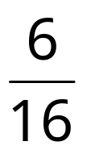

Writing Fractions in their Simplest Form

✗
Again, dividing by a factor (in this case 3) that is not the HCF will not give you the fraction in simplest form.
Example 3: Simplify

Slide 18
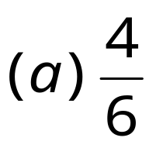
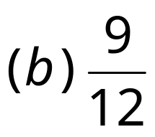
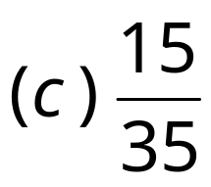
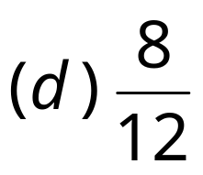
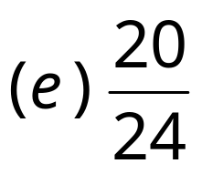
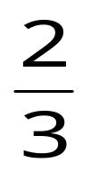




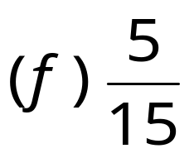
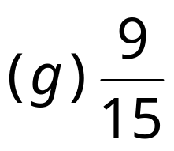
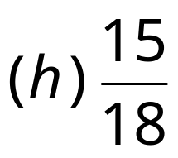
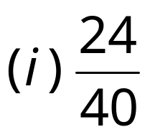
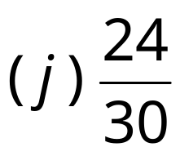





Questions
Writing Fractions in their Simplest Form
Express the following fractions in their simplest form.

Slide 19
Worksheet
Writing Fractions in their Simplest Form
Express the following fractions in their simplest form.

